Slide 1
Tsinghua University Economic History and Development in Latin America Instructor: Prof. Lucas Llach (affiliation: Universidad Torcuato Di Tella, Argentina) Lecture 5/8. Latin America in Three World Crises: the Road to Industrialization (1914-1950)

Slide 2
Roadmap
Recap of the export led model in LatAm (1850-1914)
Types of shock in an open economy
From the export led growth era to the First World War and the 1920s
Between Depression and World War II

Slide 3
Roadmap
Recap of the export led model in LatAm (1850-1914)
Types of shock in an open economy
From the export led growth era to the First World War and the 1920s
Between Depression and World War II

Slide 4
Export led growth ¿and development? 1850-1914
Substantial GDP growth
Particularly in the "Southern Cone" + Brazil, immigration and capital inflows for FDI (railways, infrastructure)
The transport revolution, an assymetric shock favoring in particular exporters of "heavy" products (esp cereals), plus other "commodity lottery" winners (rubber, refrigerated meat, increasingly oil).
What about manufacturing? The "Staple Theory" of growth and the development of light industry.
What about welfare?
Was the model sustainable?

Slide 5
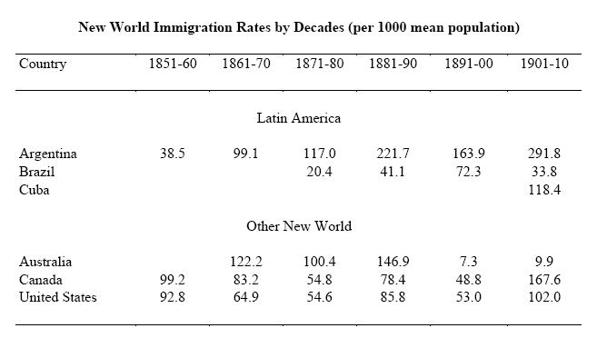
Migration and the new societies

Slide 6
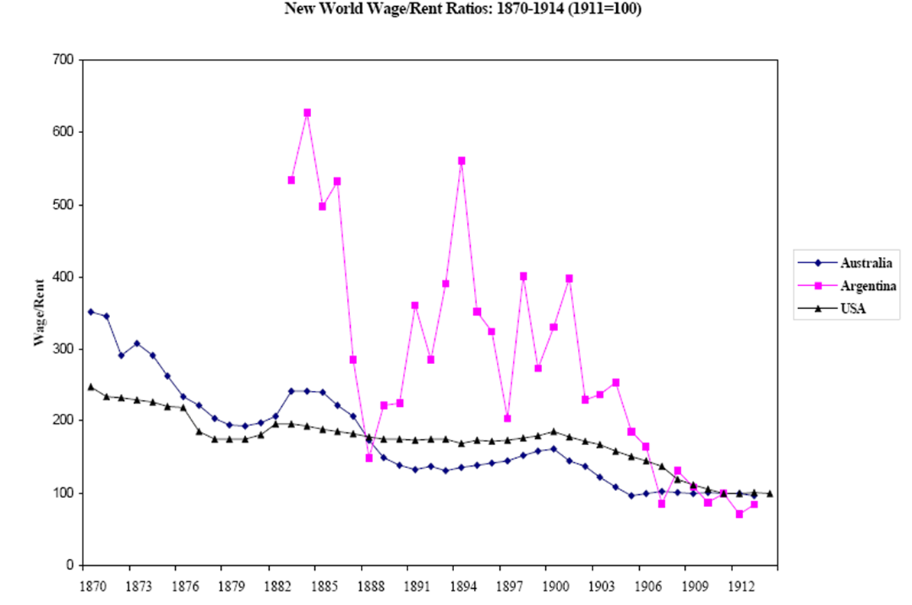
Factor endowments and factor prices

Slide 7
Roadmap
Recap of the export led model in LatAm (1850-1914)
Types of shock in an open economy
From the export led growth era to the First World War and the 1920s
Between Depression and World War II

Slide 8
The Economics of War vs The Economics of Depression
Economics of War (1914-18, 1939-45, ¿2022?)
Supply of civil goods (and labor) become scarce
dedication of resources to the war effort
disruptions in supply in war zones
Demand tends to be high
governments' spending
Higher commodity prices
In world wars (not 2022 🙏), disruptions in transport
Policy reaction: securing supply from "emerging economies".
Capital markets: flight to quality

Slide 9
The Economics of War vs The Economics of Depression
Economics of Depression (1930s, 2008)
Demand falls
Goods (and labor) become abundant relative to demand
Deflationary pressures
Policy reaction: protectionism so as to keep local demand up.
Capital markets: flight to quality.

Slide 10
Roadmap
Recap of the export led model in LatAm (1850-1914)
Types of shock in an open economy
From the export led growth era to the First World War and the 1920s
Between Depression and World War II

Slide 11
Transition or "the missing link": World War I and Its Aftermath
World War I:
Disruption in imports and some "import substitution"
Disruption in finance in capital-dependent countries
But: basically recessionary becuase of import dependence and shipping problems
The Aftermath
The end of the Gold Standard and instability in prices and terms of trade
The USA rise to prominence, the "Dance of the Millions" and the "Roaring Twenties"
Still "export led growth"?

Slide 12
Roadmap
Recap of the export led model in LatAm (1850-1914)
Types of shock in an open economy
From the export led growth era to the First World War and the 1920s
Between Depression and World War II

Slide 13
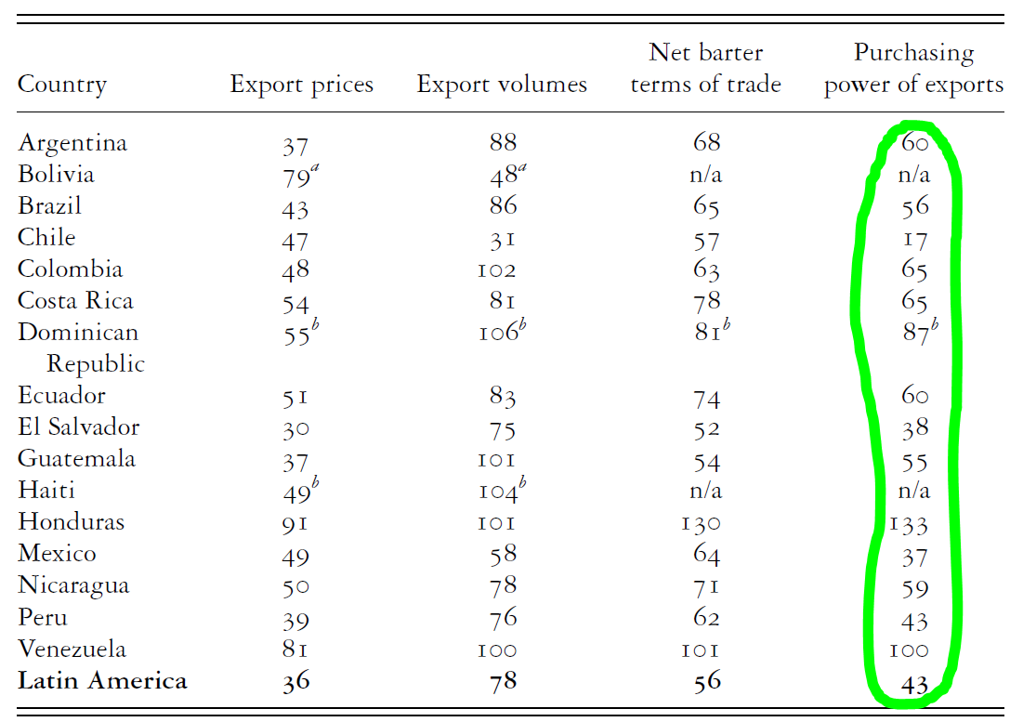
The shock of the Depression (I) Volume and Price of exports, 1928=100

Slide 14
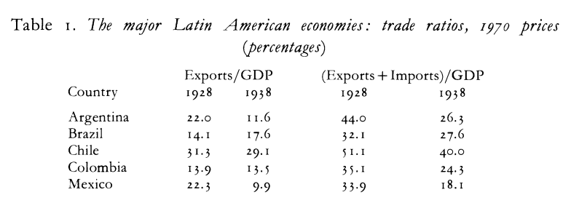
The Shock of the Depression (II)
Source: R. Thorpe (1992)

Slide 15
Policy Reactions to the Depression
"Reactive countries", esp Southern Cone, Brazil and Mexico
"Passive countries", Caribbean, northern South America

Slide 16
Policy reactions to Depression
Exchange rate
"Active" countries: exchange rate controls or multiple exchange rates and devaluations as a way of restoring balance of payments equilibrium.
"Passive" countries: fixed to gold (which itself devalued in 1933).
Commercial Policy
"Multiple exchange rates" sometimes meant a more devalued exchange rate for imports than exports, which is equivalente to protection.
International negotiations in a world turning away from multilateralism. Buy from those that buy from us.
Tariff increases.

Slide 17
Policy reactions to Depression
Debt:
Mostly, defaults
Fiscal/monetary
New financial & monetary systems after departure from gold
Movements towards broader fiscal bases and away from just tariff revenues
Gradually, a move to "Keynesian" policies, eg. road construction.

Slide 18
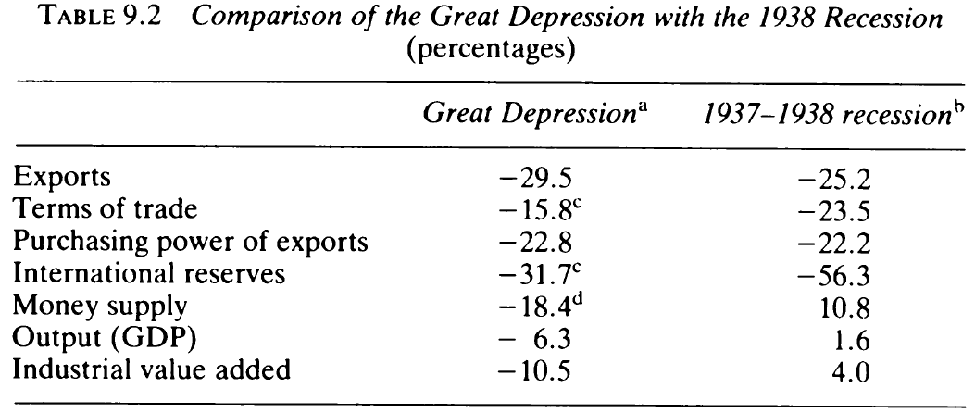
Policy reactions to Depression: Mexico as an example
Source: Cárdenas in Thorpe (ed.) readings.

Slide 19
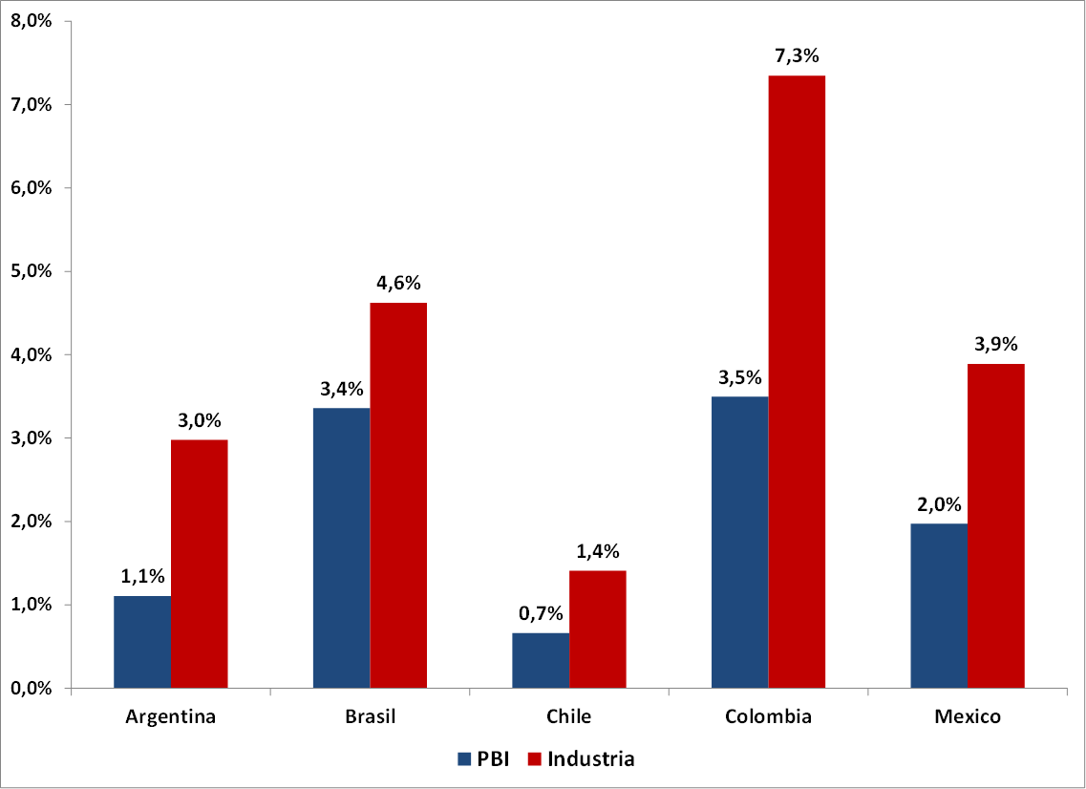
GDP and manufacturing rates of growth in the 1930s

Slide 20
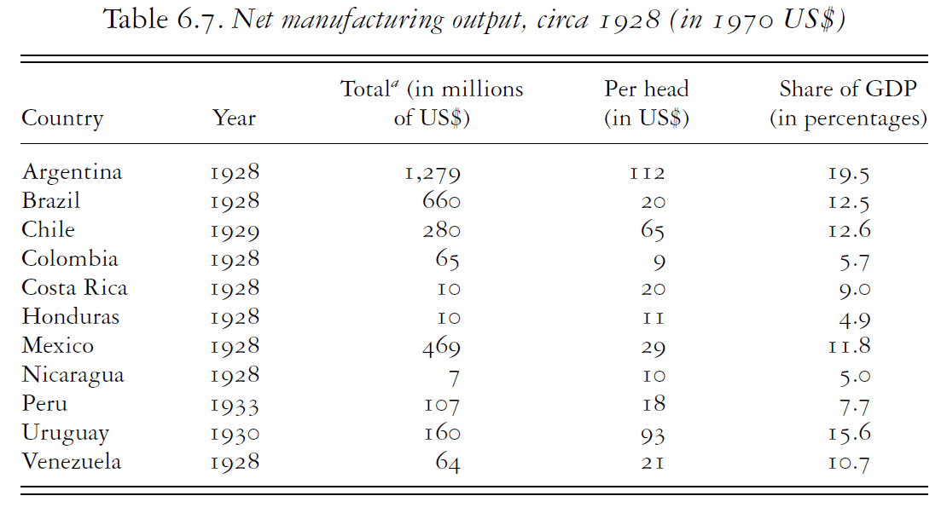
Manufacturing: Change or Continuity?
Source: Bulmer Thomas (2003)

Slide 21
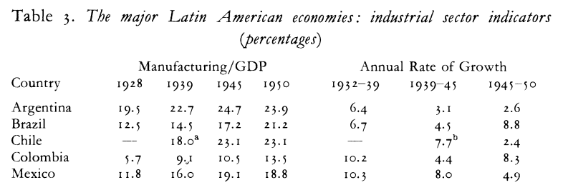
Manufacturing: Change or Continuity?
Source: R. Thorpe (1992)

Slide 22
Industrialization in LatAm
Joseph Love (1994): "Industrialization in Latin America was a fact before being a policy, and a policy before being a theory".
Hirschman (1971): "It was expected that industrialization would change the social order, and all it did was to produce manufactures".

Slide 23
The Rationale of Protection
Fiscal (clear since the 19th century)
Interest groups (starting in the late 19th century).
Defence of the balance of payments (1930s?)
Employment, manufacturing (since the 1930s)
Real wages? (same as "employment" plus effect on food prices in food exporters).

Slide 24
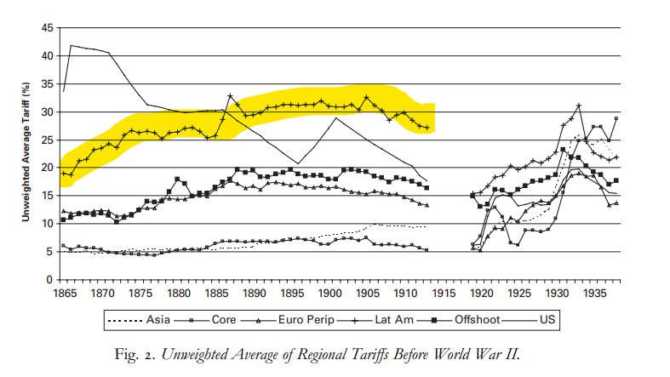
Always Protectionist? Why?

Slide 25
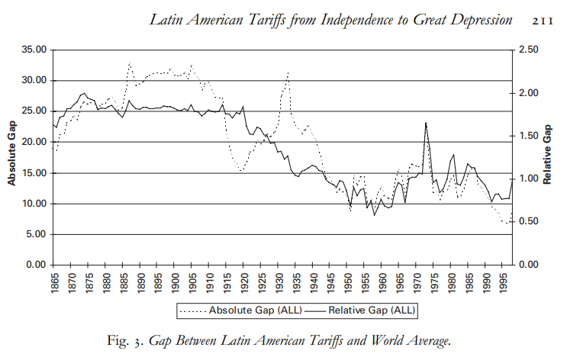
Always Protectionist? Why?

Slide 26
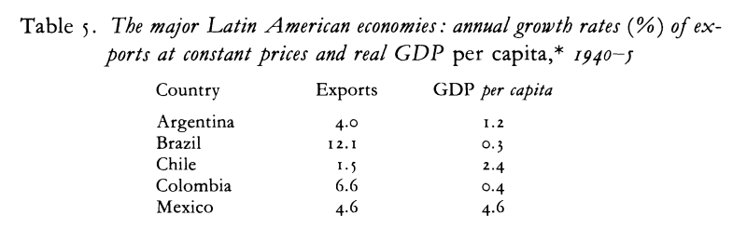
War
Some increase in intra-LatAm exports.
"Plan Pinedo" of Argentina a first blueprint at regional (re?)integration.
Source: R. Thorpe (1992)

Slide 27
Postwar: The Rationale of Import Substituting Industrialization (ISI)
Depression + war: back to normal?
Theory and the ISI
The 2 sector models and modernization
Big Push
Balanced v unbalanced growth
Forward and backward linkages
The "Lewis" model
Prebisch and export pessimism
The distributional impact of ISI.

Slide 28
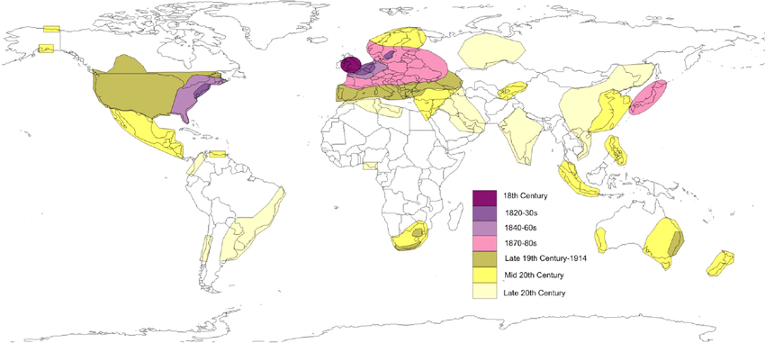
LatAm, not the only "late industrializer"
Asia and Eastern Europe also faced the challenges of late industrialization
What were the similarities and differences?

Slide 29
Postwar: Industrialization as a policy The instruments
How to promote an inward-looking industrialization?
Tariffs
Import quotas
Multiple exchange rates / taxes on exports
Directed credit
State property in big scale projects

Slide 30
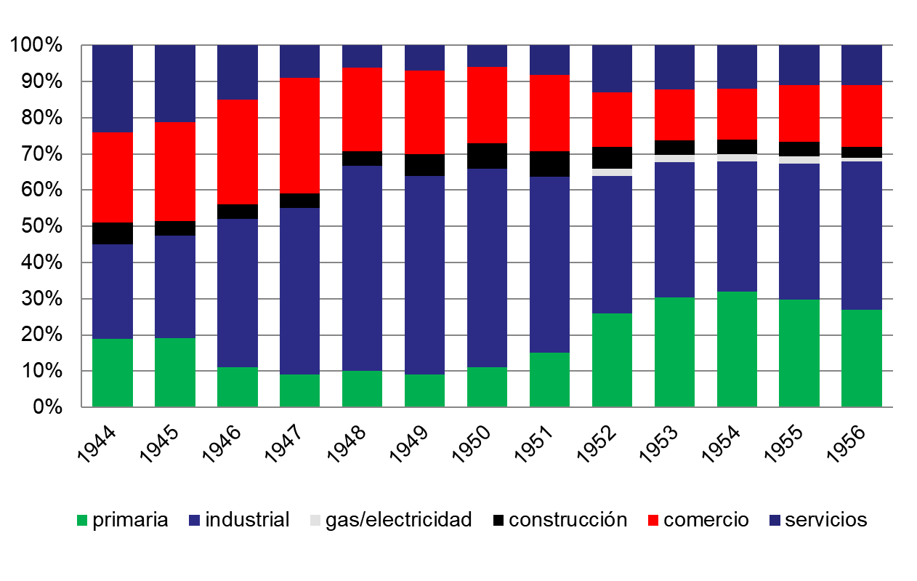
Directed credit: Argentina

